Slide 1

Placental Bioinformatics Course
Dr Russell S. Hamilton
Email: rsh46@cam.ac.uk
Twitter: @drrshamilton
Dr Xiaohui Zhao
Email: xz289@cam.ac.uk
Dr Malwina Prater
Email: mn367@cam.ac.uk
Course Materials:
https://github.com/CTR-BFX/2019-PlacentalBiologyCourse
License: Attribution-Non Commercial-Share Alike CC BY-NC-SA ( https://creativecommons.org/licenses/by-nc-sa/ )
Attribution: You must give appropriate credit, provide a link to the license, and indicate if changes were made.
You may do so in any reasonable manner, but not in any way that suggests the licensor endorses you or your use.
NonCommercial: You may not use the material for commercial purposes.
ShareAlike: If you remix, transform, or build upon the material, you must distribute your contributions under the same license as the original.
Version 0.1: 20190619

Slide 2
Program
Lecture 1: What is RNA-Seq?
Introduction to RNA-Seq and sequencer options
From Sequencer to Quality Control and Aligning reads
Practical 1:
From FASTQ to BAM
Lecture 2: Gene Counts to hypothesis testing
Experimental Design
Gene quantification
Differential Gene Expression Analysis
Practical 2:
BAM to DEGs
Russell S. Hamilton (rsh46@cam.ac.uk), Xiaohui Zhao (xz289@cam.ac.uk) & Malwina Prater (mn367@cam.ac.uk) 2

Slide 3
Program
Lecture 1: What is RNA-Seq?
Introduction to RNA-Seq and sequencer options
From Sequencer to Quality Control and Aligning reads
Russell S. Hamilton (rsh46@cam.ac.uk), Xiaohui Zhao (xz289@cam.ac.uk) & Malwina Prater (mn367@cam.ac.uk) 3

Slide 4
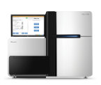
What is RNA-Seq?
Bulk RNA-Seq (poly-A capture)
Extract RNA
Library Prep
Tissue / Cells of Interest
Sequencer
FASTQ
@K00254:75:HGHVHBBXX:1:1101:1550:1297 1:N:0:AACCAG
AATTTGCAGTAACTATTGCTGTTTTATTTAACAATGCCTTGTGACCAGTT
+
AAF-FJJJJFJJJJJJJJJJJJJJJJJJJJAJJJJJJJJJ<JJJJJJJJF
@K00254:75:HGHVHBBXX:1:1101:2057:1297 1:N:0:AACCAG
CAGTTTTTCAGCCTCCTGTTGCTTCTTTTGCTGTTCAGACTAAAAGAAAG
+
AAF-AFJJJJJJJJJJFFAFFJJJJFJJJJJJJJJJJJJJJJJJJJJJJF
@K00254:75:HGHVHBBXX:1:1101:2625:1297 1:N:0:AACCAG
AGACTTTACTTTCTGAGTTTTGTTTATTTTTTCCAATTTTCATAAATTTA
+
AAFFFJJJJJJJJJJJJAFJJJJJJJJJJJAJJJJJJJJJJJJJJJJJJJ
@K00254:75:HGHVHBBXX:1:1101:2666:1297 1:N:0:AACCAG
AGGTTTGACACATTTTCCTGGGGCTGCTCTTCACTGGTAGCCCATTCTGA
+
AAAAFFJJJJJJJJJJJJJJJJJJJJJ7FAAJJJJJJJFJJJJJFFJ<JJ
@K00254:75:HGHVHBBXX:1:1101:3011:1297 1:N:0:AACCAG
GTGATCAACAGCATTTATTTTCCCTTTTGAGGAACTGAAGAGTTGACAGC
+
AAFFFJJJJJJJJJJJJJJJJJJJJFJJJJJJJJJJJJJJJJJJJJJJJJ
@K00254:75:HGHVHBBXX:1:1101:3214:1297 1:N:0:AACCAG
GGAATACACTTTGTAACAGCAGTCTGCCAACCCTGAAGAAATTCAGGTCT
+
AAFFFJJJJJJJJJJJJJJJJJFJ<JJJJJJJJJJJJJJJJJJJJJJJJJ
@K00254:75:HGHVHBBXX:1:1101:3234:1297 1:N:0:AACCAG
CTTTGTGTTTGATCCCTAACTAGTAGCACAGTTTGGGGAAGCTGCAAAAC
+
AAFFFJJJJJJJJJJJFJJJJJJJJJJJJJJAJFJJJJJJJJJJJJJJJJ
@K00254:75:HGHVHBBXX:1:1101:4411:1297 1:N:0:AACCAG
AAGGATTCAGGTATTAGTGAGGAGGTCTCAGAAGAACTCTGTGCCTACCG
+
AAAF<AFAJJA-F7<F<-<7FJJJJ-7-7<FJFF7-<FFJFA7-FA<FJ-
@K00254:75:HGHVHBBXX:1:1101:4777:1297 1:N:0:AACCAG
TCTCCTCTTGGTGCTTGCATCTGACATGTTGATGCTCAACCTTTCTGGGA
+
AAFFFJJJJJJFJJJJJJJJJJJJJJJJJJJJJJJFJJJJJJJJJJJJJJ
@K00254:75:HGHVHBBXX:1:1101:5325:1297 1:N:0:AACCAG
CTCTGAGCTGAAGTAACTGTGCAAGTGGATTGGACATATCTGCAAAGGAG
+
AAFFFJJJJJJJJJJJJJJJJJJJJJJJJJJJJJJJJJJJJJJJJJJJJJ
@K00254:75:HGHVHBBXX:1:1101:6035:1297 1:N:0:AACCAG
TTAGTTTTGATACCTCAGAGCTCACACACCACATGTAGCTCCCCCATCTC
+
scRNA-Seq (e.g. DropSeq)
Amazon.com
Isolate Cells
Extract RNA
Library Prep
Russell S. Hamilton (rsh46@cam.ac.uk), Xiaohui Zhao (xz289@cam.ac.uk) & Malwina Prater (mn367@cam.ac.uk) 4

Slide 5
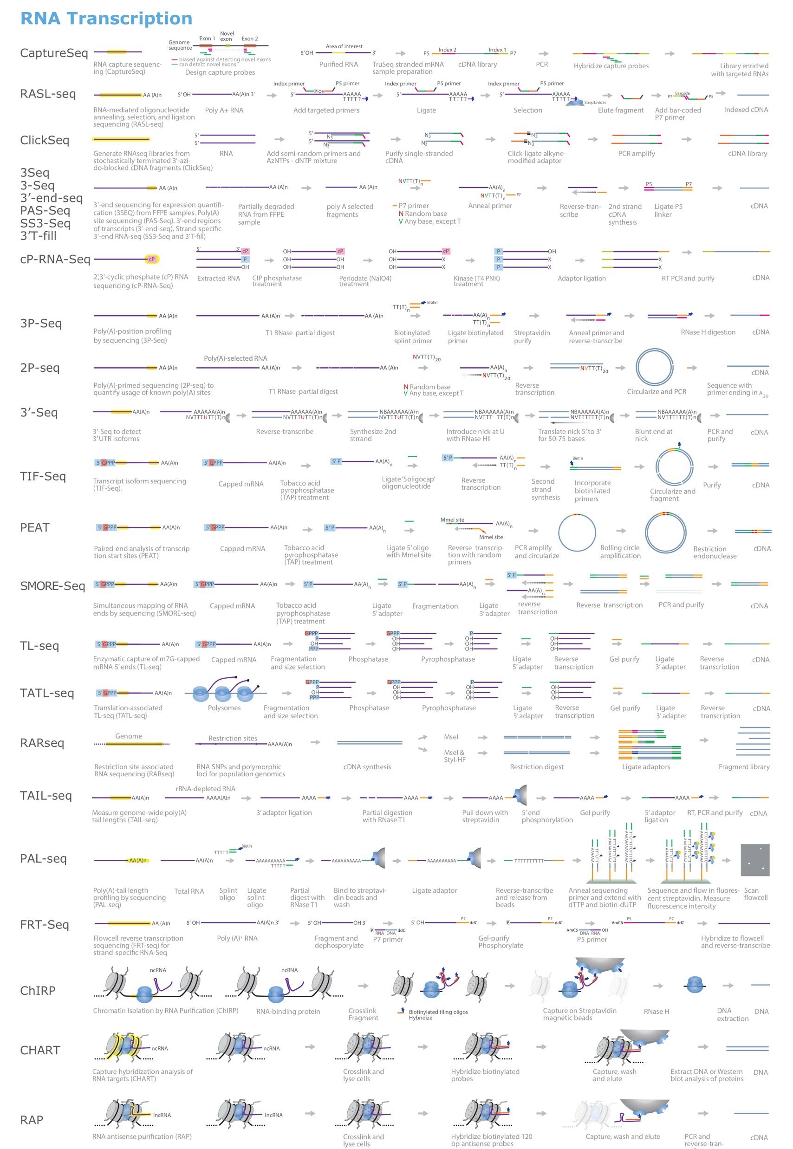
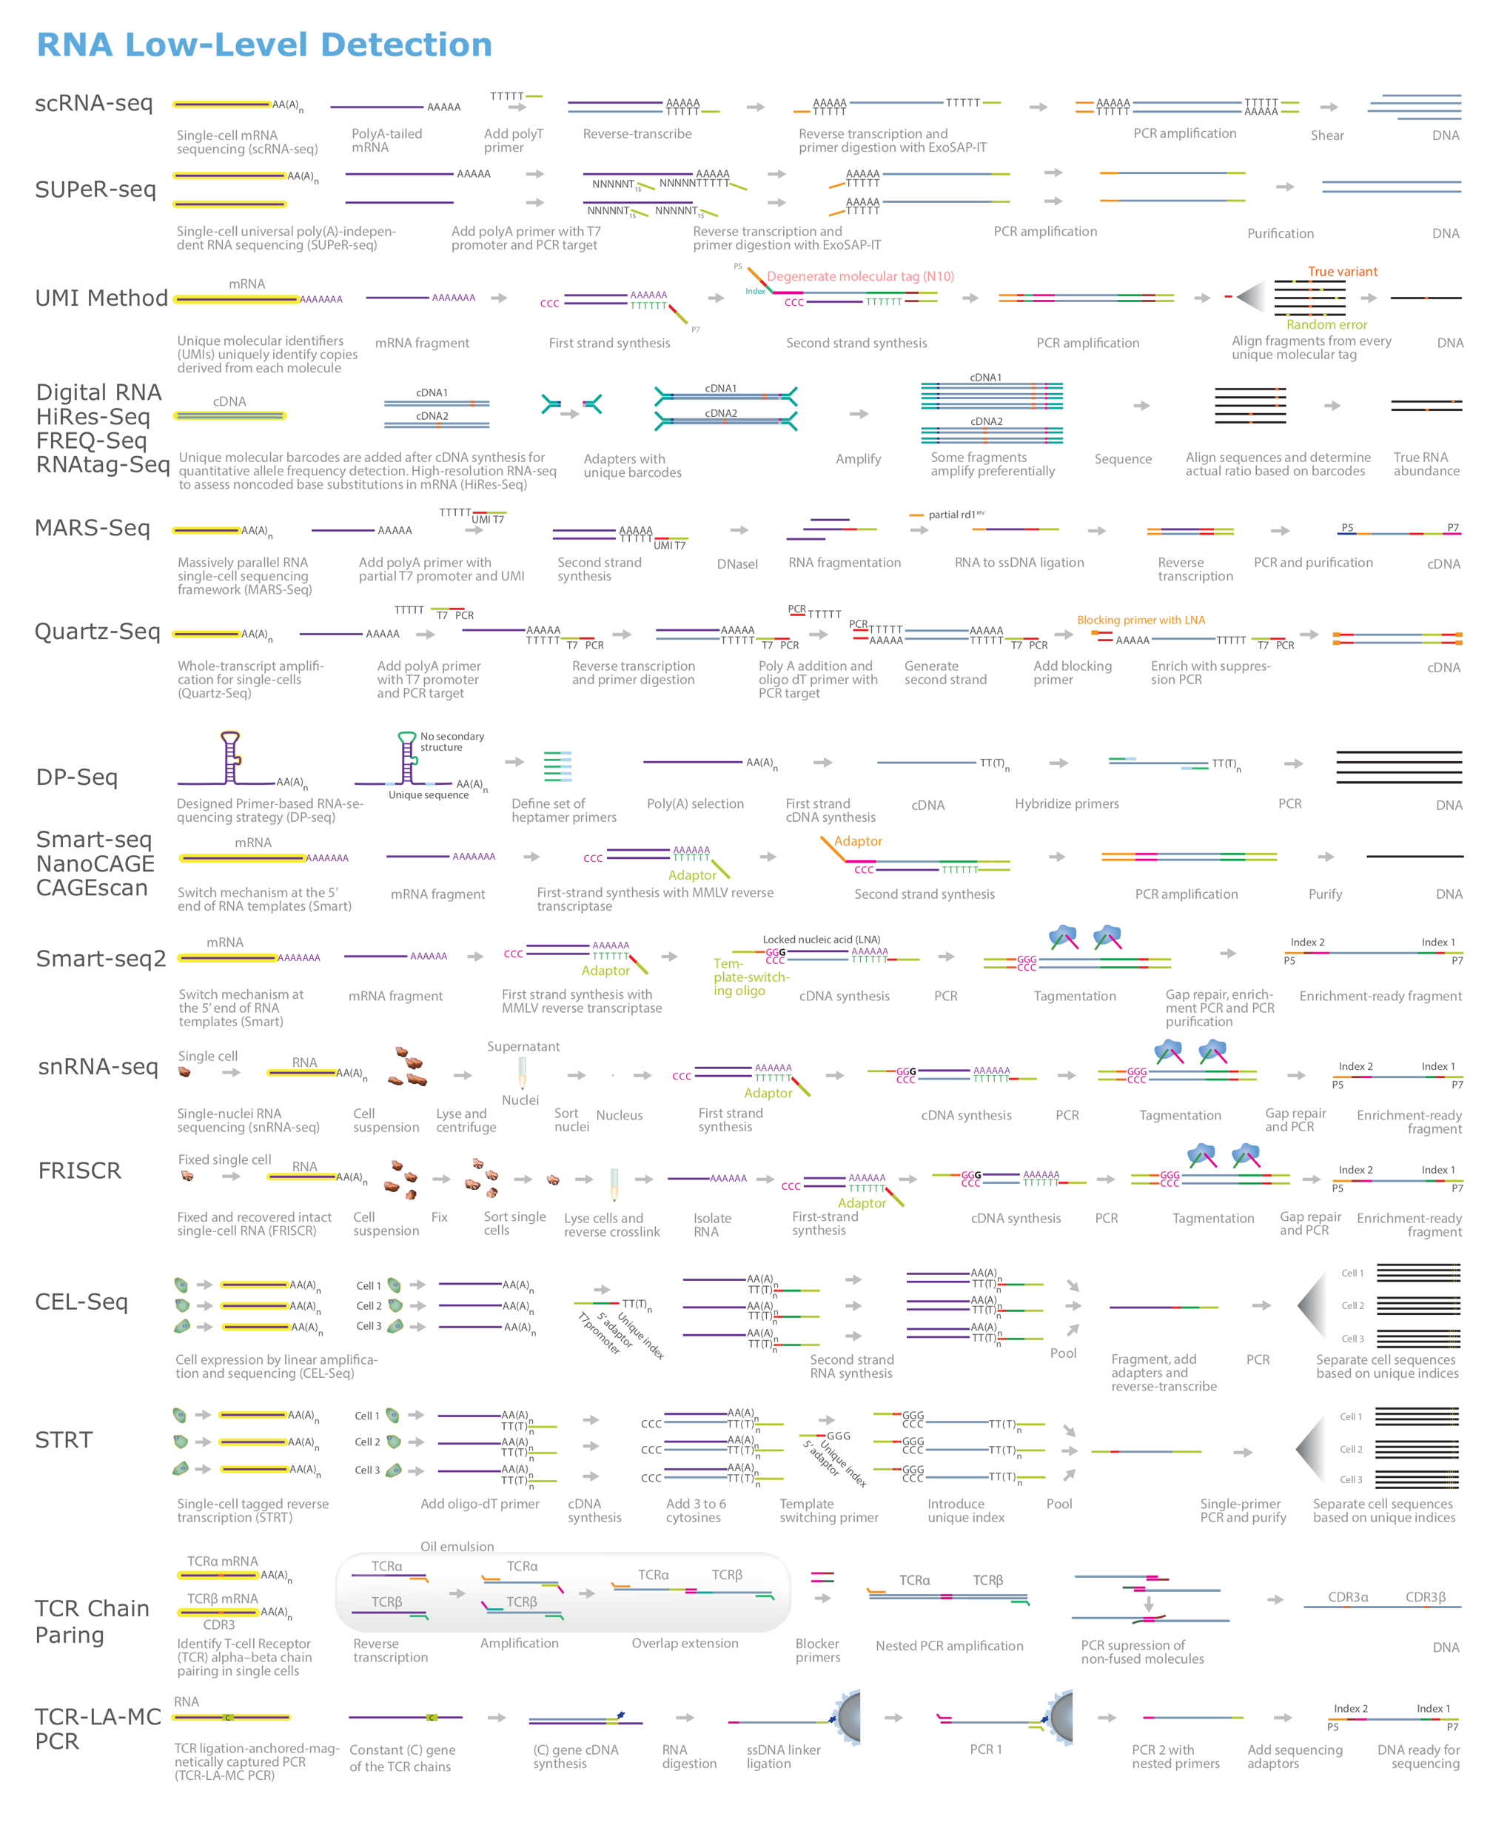
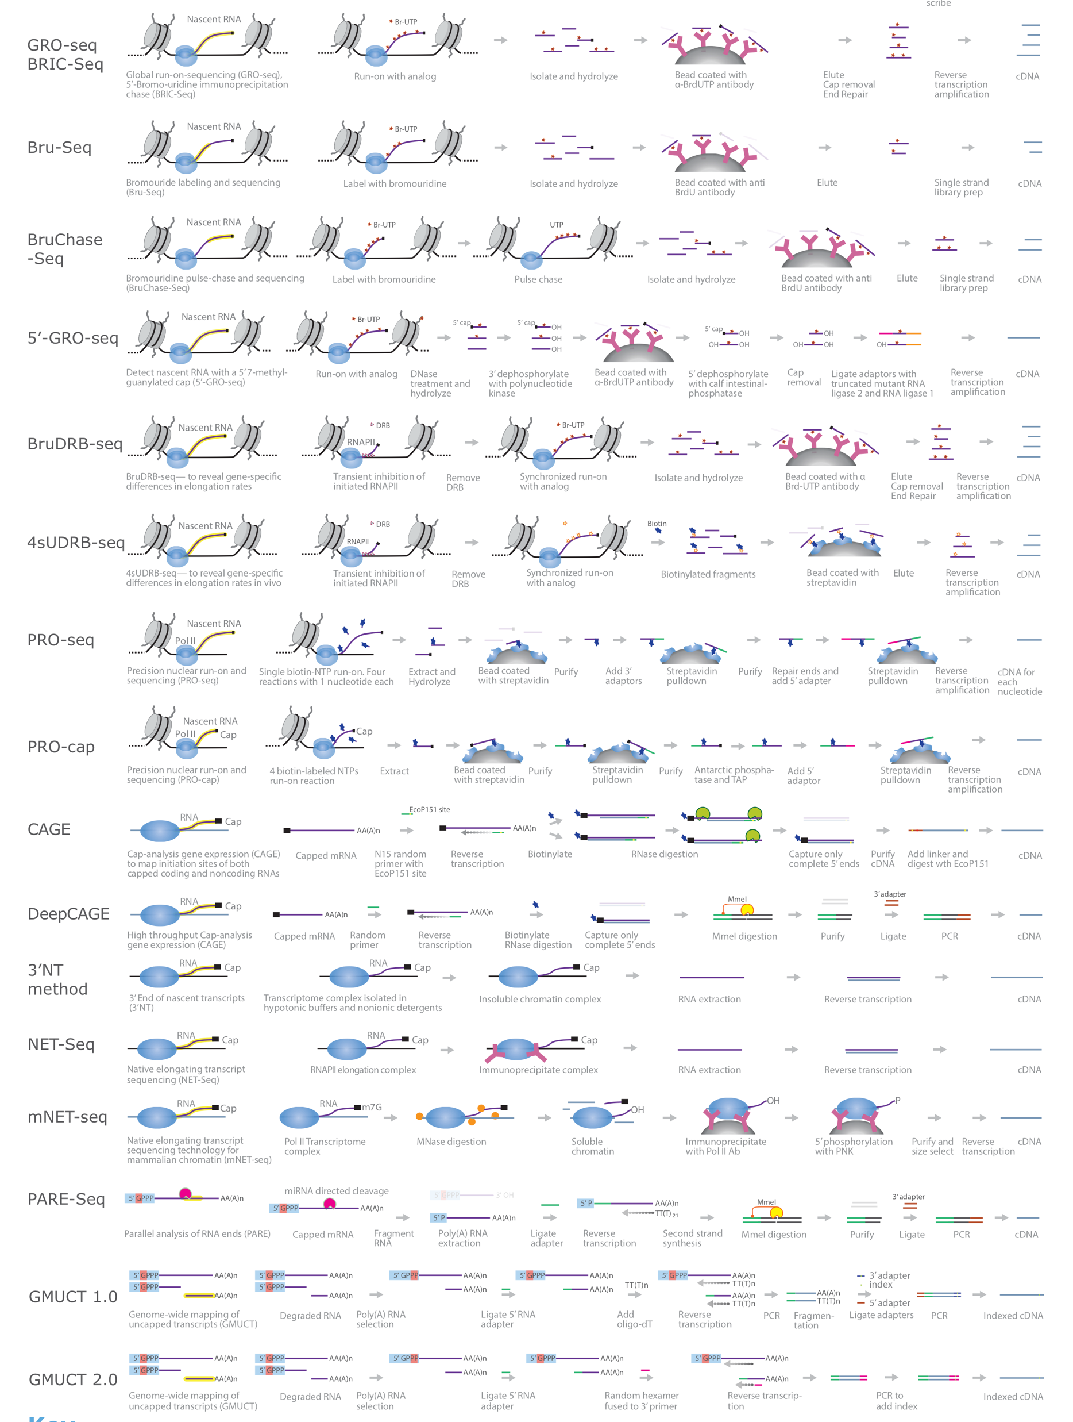
Different flavours of RNA-Seq?
https://emea.illumina.com/content/dam/illumina-marketing/documents/applications/ngs-library-prep/for-all-you-seq-rna.pdf
Russell S. Hamilton (rsh46@cam.ac.uk), Xiaohui Zhao (xz289@cam.ac.uk) & Malwina Prater (mn367@cam.ac.uk) 5

Slide 6
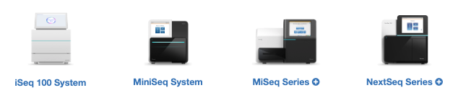
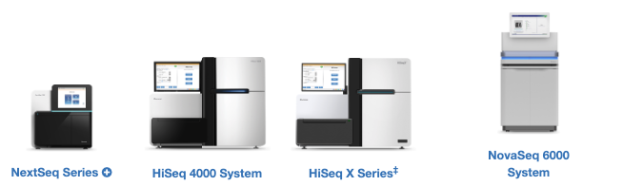
Sequencing Technologies
Sequencing By Synthesis
Single Molecule Real Time
Sequencing (SMRT)
Sequencing through protein pores
Illumina
Short Read Sequencers 50-300bp
PacBio
Long Read Sequencers 1-10Kb
Oxford Nanopore Technologies
Long Read Sequencers 1Kb – 1Mb
Cumulative Errors
Stochastic Errors
Russell S. Hamilton (rsh46@cam.ac.uk), Xiaohui Zhao (xz289@cam.ac.uk) & Malwina Prater (mn367@cam.ac.uk) 6

Slide 7
Sequencing By Synthesis
Bulk RNA-Seq (poly-A capture)
Tissue / Cells of Interest
Extract RNA
Library Prep
Amazon.com
Sequencing By Synthesis (Illumina)
Hybridise to flow cell
Sequencing primer
Fluorescently labelled nucleotides
Sequencing Cycle 1
Sequencing Cycle 2
G
C
C
C
G
G
C
C
G
G
A
T
A
C
Wash
A
A
C
C
T
G
T
T
A
G
…
G
C
A
T
Flow Cell
Flow Cell
Flow Cell
Flow Cell
Russell S. Hamilton (rsh46@cam.ac.uk), Xiaohui Zhao (xz289@cam.ac.uk) & Malwina Prater (mn367@cam.ac.uk) 7

Slide 8
Sequencing Quality
Sequencing by synthesis errors are cumulative due to phasing
Good
Quality Score (Phred)
Bad
Read Position
Cycle 300
Cycle 1
Russell S. Hamilton (rsh46@cam.ac.uk), Xiaohui Zhao (xz289@cam.ac.uk) & Malwina Prater (mn367@cam.ac.uk) 8

Slide 9
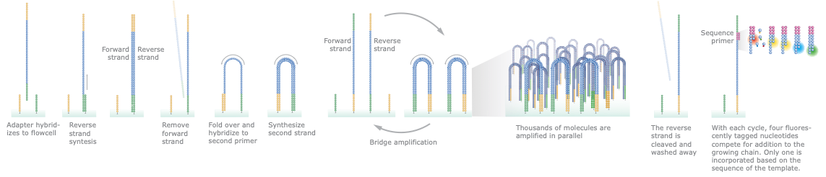
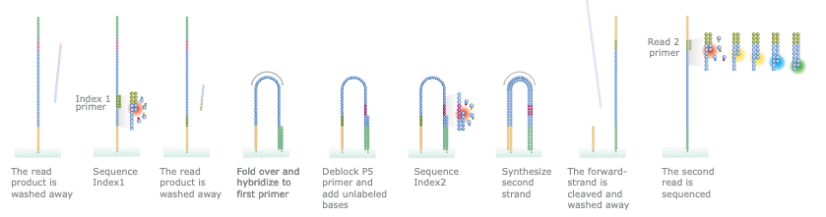
Single End Vs Paired End
Single End Sequencing
Read 1
150bp
Paired End Sequencing
Starts from SE sequencing method
Read 1
Read 2
150bp
150bp
500bp
Russell S. Hamilton (rsh46@cam.ac.uk), Xiaohui Zhao (xz289@cam.ac.uk) & Malwina Prater (mn367@cam.ac.uk) 9

Slide 10
Sequencing Depth
Bulk RNA-Seq (poly-A capture)
Library prep includes a sample index, so multiple samples can be sequenced on the same run
Tissue / Cells of Interest
Extract RNA
Library Prep
Amazon.com
Global transcriptome analysis 30-60M reads
In depth transcriptome analysis 100-200 reads
Sequencer Choice
10 Samples = ~40M reads per sample
20 Samples = ~20M reads per sample
30 Samples = ~13M reads per sample
NextSeq
400M Reads Per Run
Russell S. Hamilton (rsh46@cam.ac.uk), Xiaohui Zhao (xz289@cam.ac.uk) & Malwina Prater (mn367@cam.ac.uk) 10

Slide 11
Sequencer Output
Bulk RNA-Seq (poly-A capture)
Tissue / Cells of Interest
Extract RNA
Library Prep
Sequencer
Amazon.com
FASTQ File
Contains millions of reads
Each read represented by 4 lines
Read Identifiers
@K00254:75:HGHVHBBXX:1:1101:1550:1297 1:N:0:AACCAG
AATTTGCAGTAACTATTGCTGTTTTATTTAACAATGCCTTGTGACCAGTT
+
AAF-FJJJJFJJJJJJJJJJJJJJJJJJJJAJJJJJJJJJ<JJJJJJJJF
Read Sequence
Separator
Sequence = C
Quality J = Q41 = good
Quality Score (Phred Scale)
Russell S. Hamilton (rsh46@cam.ac.uk), Xiaohui Zhao (xz289@cam.ac.uk) & Malwina Prater (mn367@cam.ac.uk) 11

Slide 12
Post Sequencing
@K00254:75:HGHVHBBXX:1:1101:1550:1297 1:N:0:AACCAG
AATTTGCAGTAACTATTGCTGTTTTATTTAACAATGCCTTGTGACCAGTT
+
AAF-FJJJJFJJJJJJJJJJJJJJJJJJJJAJJJJJJJJJ<JJJJJJJJF
FASTQ
Did the sequencing perform well?
Read qualities
GC bias
Adapter content
Practical Exercises
How to assess quality of sequencing output
No information on where the read came from
Which gene is it from?
How many reads for each gene?
How to align reads to a reference genome
Russell S. Hamilton (rsh46@cam.ac.uk), Xiaohui Zhao (xz289@cam.ac.uk) & Malwina Prater (mn367@cam.ac.uk) 12

Slide 13

Read Alignment to Reference Genome
@K00254:75:HGHVHBBXX:1:1101:1550:1297 1:N:0:AACCAG
AATTTGCAGTAACTATTGCTGTTTTATTTAACAATGCCTTGTGACCAGTT
+
AAF-FJJJJFJJJJJJJJJJJJJJJJJJJJAJJJJJJJJJ<JJJJJJJJF
FASTQ
Reference Genome
https://www.ensembl.org/Mus_musculus
Option 1: Genome Assembly
Chromosome Sequences
Mus_musculus.GRCm38.dna.chromosome.10.fa.gz
Gene Annotations (location of genes and exons etc)
Mus_musculus.GRCm38.84.gtf
Option 2: Transcriptome Assembly
Known Transcript Sequences
Mus_musculus.GRCm38.cdna.all.fa.gz
Russell S. Hamilton (rsh46@cam.ac.uk), Xiaohui Zhao (xz289@cam.ac.uk) & Malwina Prater (mn367@cam.ac.uk) 13

Slide 14
Read Alignment to Reference Genome
Option 1: Genome Alignment using e.g. STAR
1. Align reads to reference genome
Get location of match (chr, start, end)
Check if alignment is unique
Does the read lie within a gene?
Does the read lie within or span an exon?
Chromosome Sequence Files (FASTA file)
Gene and exon locations (GTF File)
Exon 1
Exon 2
Single exon mapping
 | STAR
Run time | hours
Hardware requirements | Multi-core
Novel Splice Sites | yes
Segments aligned and assembled
Russell S. Hamilton (rsh46@cam.ac.uk), Xiaohui Zhao (xz289@cam.ac.uk) & Malwina Prater (mn367@cam.ac.uk) 14

Slide 15
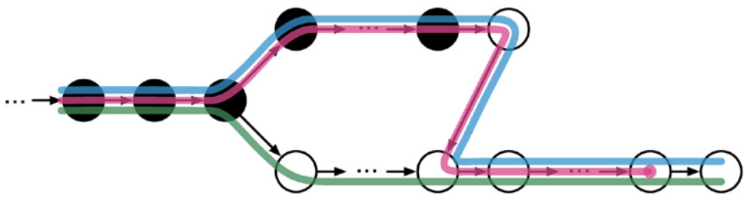
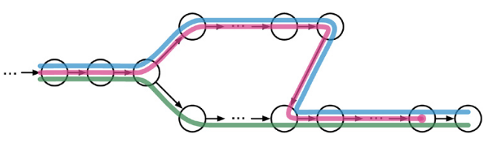
Read Alignment to Reference Genome
Option 2: Transcriptome Pseudo-Alignment using Kallisto
 | Kallisto
Run time | minutes
Hardware requirements | Laptop
Novel Splice Sites | no
Does the reads pseudo-align to a transcript – and which isoform is most likely?
Reference Transcriptome Split into Kmers
Exon 1
Exon 2
✓
Exon 1
Exon 2
✓
Exon 1
Exon 2
✗
Encoded into a ﻿de Bruijn Graph
Russell S. Hamilton (rsh46@cam.ac.uk), Xiaohui Zhao (xz289@cam.ac.uk) & Malwina Prater (mn367@cam.ac.uk) 15

Slide 16
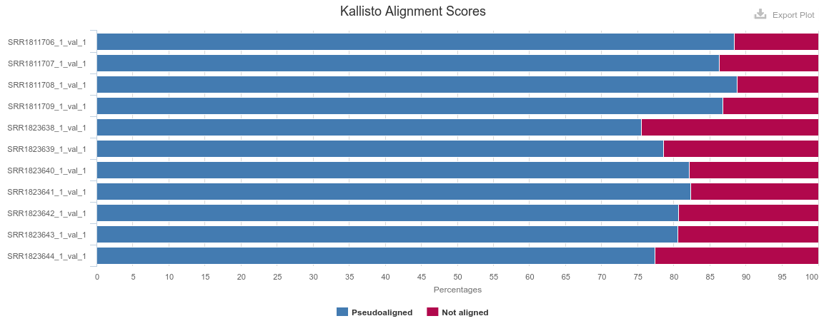
QC Alignments
Why do you never see 100% alignment?
Incomplete reference genomes / transcriptomes
Repetitive reads hard to map uniquely
Sample: Structural Variants
Copy Number Variants
Russell S. Hamilton (rsh46@cam.ac.uk), Xiaohui Zhao (xz289@cam.ac.uk) & Malwina Prater (mn367@cam.ac.uk) 16

Slide 17
Visualising the Alignments
Have all the computational tools worked as expected?
Lots of genome viewers available
IGV (Integrated Genomics Viewer)
https://software.broadinstitute.org/software/igv/
Select Reference Genome: e.g. Mouse(mm10)
Search for gene of interest
Can you see the difference in coverage between samples?
Do the reads line up with exons?
(For mRNA reads should align to exons only)
(Not part of todays practical, but an essential part of any sequencing based analysis)
Russell S. Hamilton (rsh46@cam.ac.uk), Xiaohui Zhao (xz289@cam.ac.uk) & Malwina Prater (mn367@cam.ac.uk) 17

Slide 18
Dr Russell S. Hamilton Email: rsh46@cam.ac.uk
Dr Malwina Prater Email: mn367@cam.ac.uk
Dr Xiaohui Zhao Email: xz289@cam.ac.uk
Course Materials:
https://github.com/CTR-BFX/2019-PlacentalBiologyCourse
License: Attribution-Non Commercial-Share Alike CC BY-NC-SA ( https://creativecommons.org/licenses/by-nc-sa/ )
Attribution: You must give appropriate credit, provide a link to the license, and indicate if changes were made.
You may do so in any reasonable manner, but not in any way that suggests the licensor endorses you or your use.
NonCommercial: You may not use the material for commercial purposes.
ShareAlike: If you remix, transform, or build upon the material, you must distribute your contributions under the same license as the original.

